Slide 1


Furniture Marketing System requirements

Slide 2
Team Members
Ahmed Khaled Elsharabasy
Eslam Saber Elfar
Mazen Hassan Elalfy
Mohammed Ahmed Nasr
Shrouk Sherief Elsweesy.
Omnia Azmy Elqzaz.
Rowida Mohamed Abd El-Aal
Sama Maged Rezq.

Slide 3

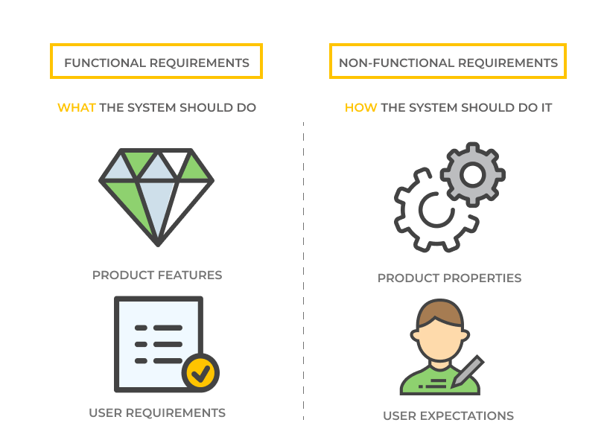
Requirements
Functional
Non-Functional
What The system should do
How The system should do it

Slide 4
Functional Requirements
Management
Client
seller

Slide 5
Management
1. Login :
The system allows management members to login.
Reset password.
2. Take backup:
Manage backup for the system continuously.
3. Update system information:
Update data of users and store and analyze it.
Add or delete or modify or check user’s account’s information.
4. Complaints:
Receiving Complaints through mailbox for the management.
Provide Technical support for problems and modification requests in the system from employees.
5. Add advertisements :
Control show or hide advertisements.
Add and delete product offers.
6. Control account:
Update account information (ex. address).

Slide 6
7. Control:
Control permissions of users(clients and sellers).
Control and manage payments and fulfillment of purchase conditions.
Control elements and categories:
Admin responsible for managing elements of the page.
Ex.
Navbar
Account
Cart
Search
Sell your product
Help & settings
Product Categories
Offers
Gallery filter
Seller rating
Product rating
You may like
Add to card
Buy & Deliver
Contact & Return
About us

Slide 7
8. Contact:
Click Contact to message seller who want to add advertisements and offers.
9. Provide Technical support:
Show messages of problems and modification requests in the system from employees.

Slide 8
Client
1. Sign up & Login :
The system allows all employees to sign up and login.
Reset password.
2. Control account:
Choose payment method.
Update account information (ex. address).
3. Search product:
Enter product information in search icon.
Choose product specifications from gallery filter.
Browse advertisements to see offers and ads.
Choose product from categories.
4. buying product:
Add number of orders of product to cart to collect orders, then Buy to purchase product.
Click Remove to remove selected orders from card.
Click Choose your location to determine the delivery location.
Click Buy to purchase and deliver it.

Slide 9
5. Enter rating:
Click number of stars of seller rating.
Click number of stars of product rating.
Add review comment about seller and product.
6. Contact:
Click Contact to message seller and return product if it’s wrong product or it’s not in good condition.
7. Complaints:
Sending Complaints through mailbox for the management.

Slide 10
Seller
1. Sign up & Login :
The system allows the seller to sign up and log in
Reset password.
2. Control account:
Update account information (ex. address).
3. Contact:
The seller click Contact to messages the client and retrieve product if it’s wrong product or it’s not in good condition.
The seller messages the management to add ad.
4. Complaints:
Sending Complaints through mailbox for the management.

Slide 11
5. Enter information:
Personal information
Name
Address
Mobile number
Email & password
Approval of the electronic contract
Payment information
Add payment information (Credit account number).
Company information
Name
Address
Mobile number
Email
Product information
Product category
Product name.
Product specification.
Product brand.
Product price.
Product offer.

Slide 12
Non-Functional Requirements
Operational
Performance
Security
Cultural & Political

Slide 13
Operational
Cross platforms.
The seller should return the product if it’s wrong product or it’s not in good condition.
The system will be user friendly, consistent, intuitive and descriptive UI.
The system should have a maximum of 2:3 clicks to reach any content.
The system should be evolvable, scalable, testable and maintainable.
Performance
Quick ask & response (under 2 sec).
The system should be available 24 hours a day.
20 minutes are specified daily on a fixed date [3 am (low-intensity hours)] to maintain and update the system.

Slide 14
Security
The system must protect the user’s privacy.
Every user should have a user-customizable visibility policy for his/her personal information such as email and study timetable.
The system will be secure and cannot affect, harm, damage the users or their devices.
Cultural & Political
The system should provide commonly used calendar formats.
The system should use a related time zone.
The system should use the currency of our country.
The system should provide language support for all users.

